Slide 1


Josh Patterson
@datametrician

Slide 3
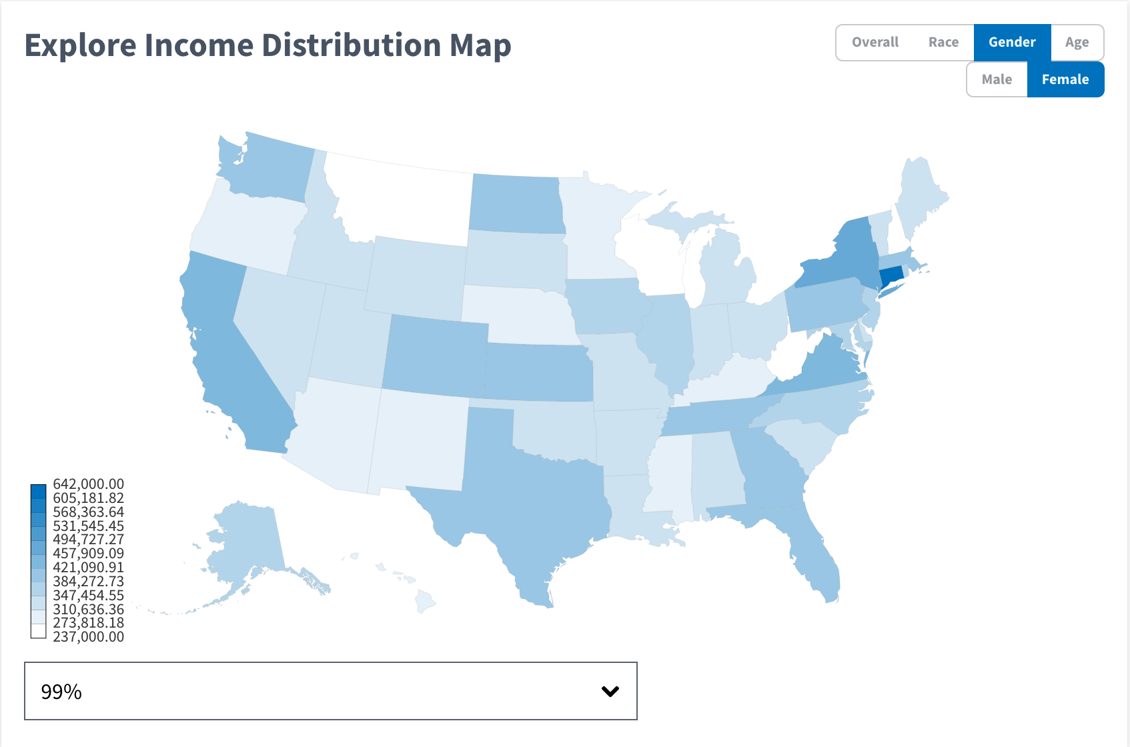

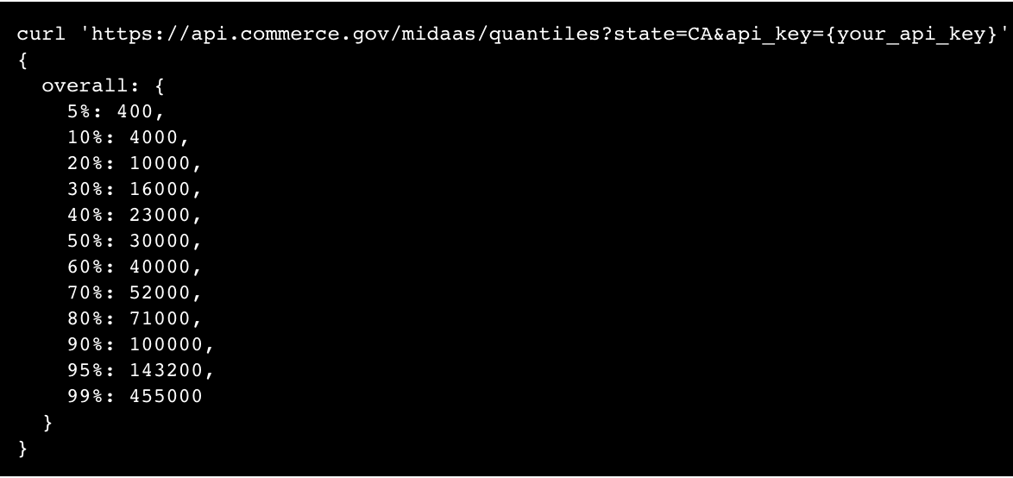

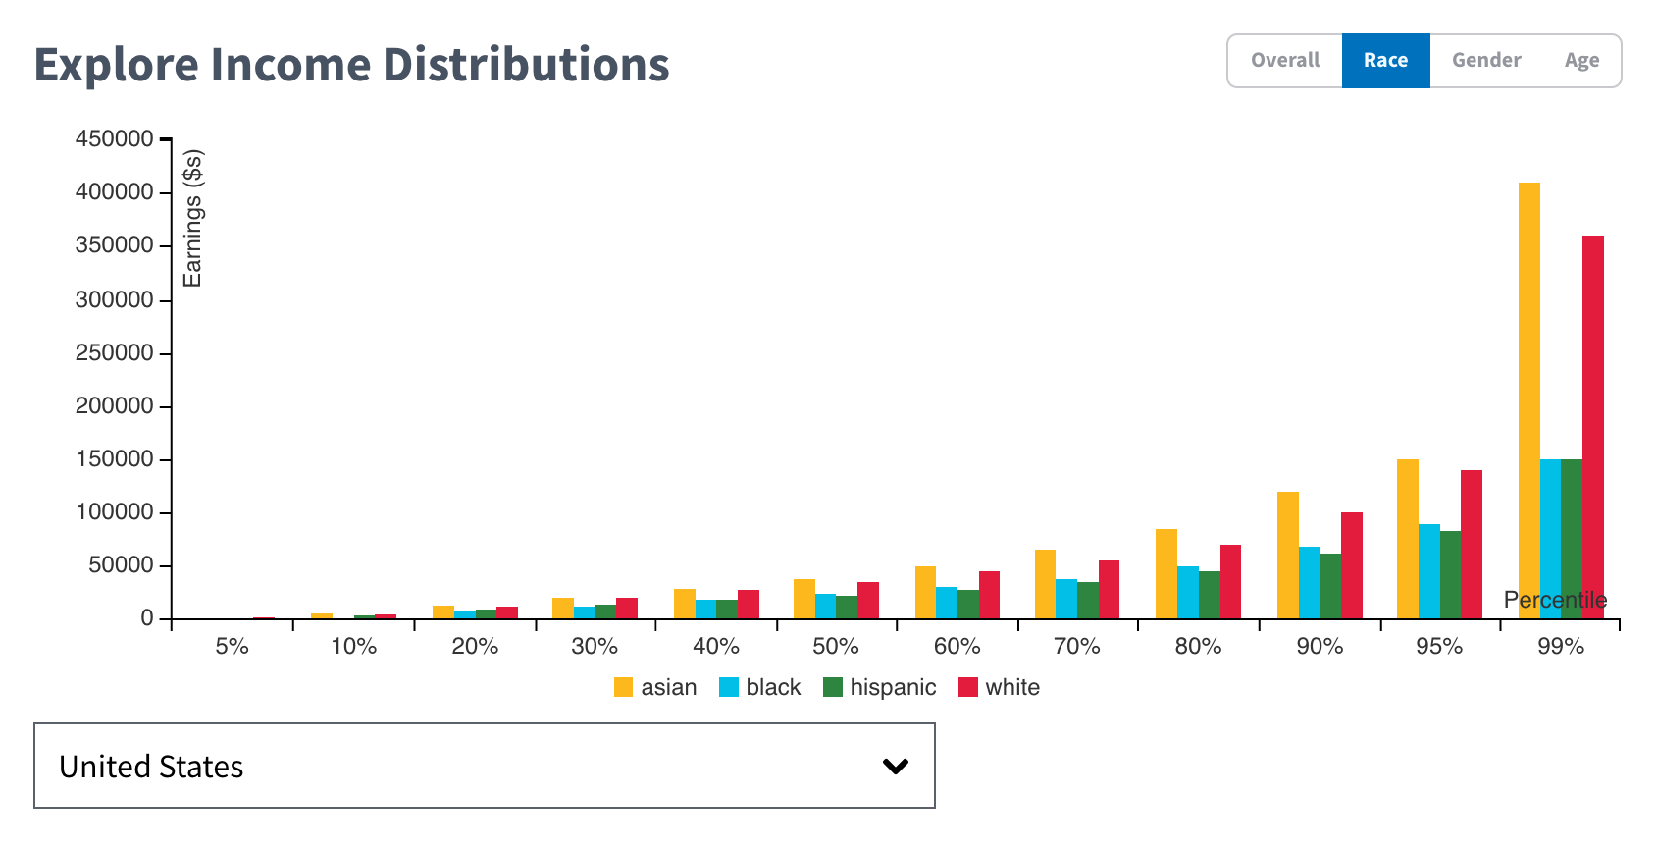

Slide 4
700 to 7 Million

Slide 5
700 to 7 Million
Open Data => Open Insights => Open Dialogue
Allow users to know information they want, interactively, & easy as Google search

